Slide 1


K.S.R.M. COLLEGE OF ENGINEERING (UGC-AUTONOMOUS) Kadapa,Andhra Pradesh, India– 516 003 Approved by AICTE, New Delhi & Affiliated to JNTUA, Ananthapuramu. An ISO 14001:2004 & 9001: 2015 Certified Institution
Second Project Review for the award of Bachelor of Technology
DESIGN OF SERIAL PERIPHERAL INTERFACE MASTER CORE
Under The Guidance of
Sri R.V. Sreehari ,M.E.,
Batch No: A 02
Project Associates
B. Sangeetha- 209Y1A0417
D. Venkat Ramesh- 209Y1A0438
D.Venugopal- 209Y1A0444
G. Nithin Kumar Reddy – 209Y1A0450
G. Nagendra prasad– 209Y1A0453
Department of Electronics and Communication Engineering
2023-2024

Slide 2
ABSTRACT
This project presents the design of the SPI master core. It is a commonly used communication protocol that allows serial data transfer between a master and multi-slave device over a short distance. In this project, we will focus on block-level architecture and develop RTL code for the same. This controller is developed using Verilog HDL based on the IEEE standards and also verified using Verilog HDL code. The main part of the SPI master core is to generate the serial clock which will be derived from the wishbone master clock. The SPI protocol works with Master-Slave configuration, in full duplex mode. This is a 4-wire transmission that includes “SCK, MOSI, MISO, SS”. MOSI will transfer the bit serially from the SPI master core to the SPI slave and MISO will receive the serial bit from the SPI slave to the SPI master

Slide 3
First Review Comments
Problem Statement
Lack of Fundamentals
Understand the Concept

Slide 4
BLOCK DIAGRAM
WISHBONE MASTER
SPI
MASTER
CORE
SS
SPI
SERIAL SLAVE
SCLK
MOSI
MISO

Slide 5
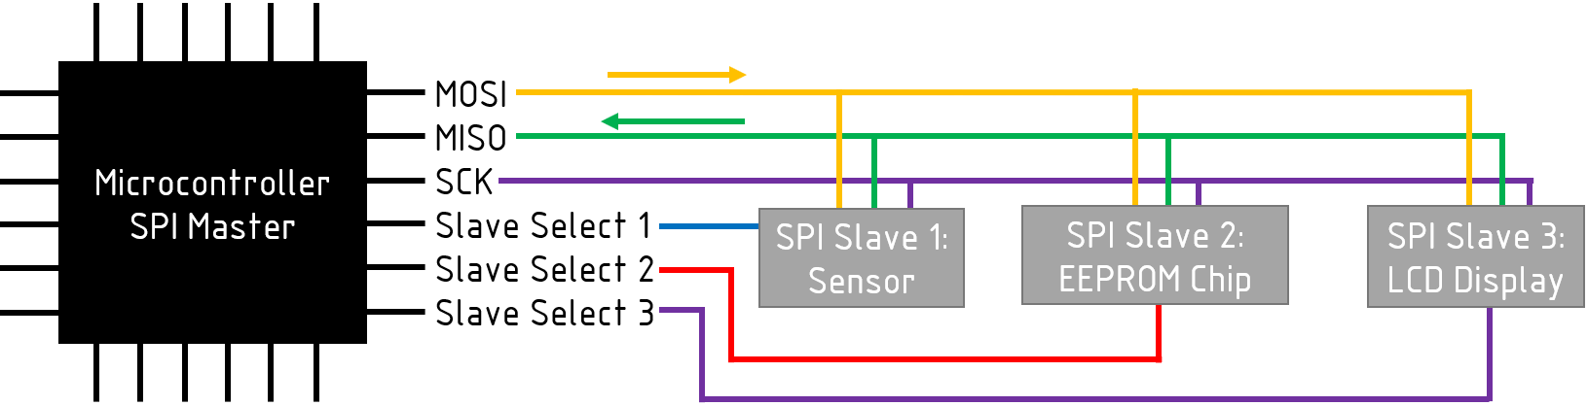
OPERATION

Slide 6
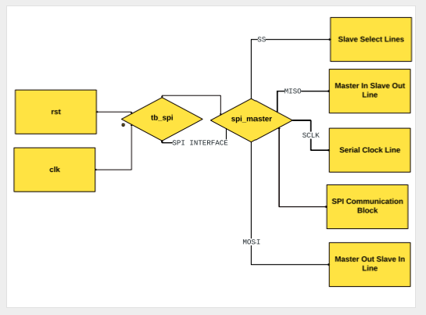
FLOW CHART

Slide 7
Algorithm
The Serial Peripheral Interface (SPI) communication protocol is a widely-used synchronous serial communication interface in embedded systems, allowing for the exchange of data between microcontrollers, sensors, and peripheral devices.
It operates on a master-slave architecture, where a single master device initiates communication with one or multiple slave devices.
In SPI communication, data is transmitted in full-duplex mode over multiple lines: MOSI (Master Out Slave In), MISO (Master In Slave Out), SCK (Serial Clock), and SS (Slave Select). The master device controls the clock signal (SCK), which synchronizes data transmission between the master and slave devices.
Each slave device is assigned a unique Slave Select (SS) line, enabling the master to select the desired slave for communication.

Slide 8
Software tool
Xilinx Vivado is a comprehensive design suite for developing and deploying programmable logic devices, primarily focusing on field-programmable gate arrays (FPGAs) and system-on-chip (SoC) devices. It serves as a powerful environment for designing, synthesizing, implementing, and verifying digital circuits
Vivado encompasses various tools and features essential for FPGA development, including high-level synthesis (HLS), hardware description language (HDL) synthesis, implementation, and debugging capabilities.
The tool supports popular HDLs such as Verilog, VHDL, and SystemVerilog, allowing designers to write and simulate their designs using familiar languages. Vivado also provides advanced synthesis and optimization algorithms to maximize design performance.

Slide 9
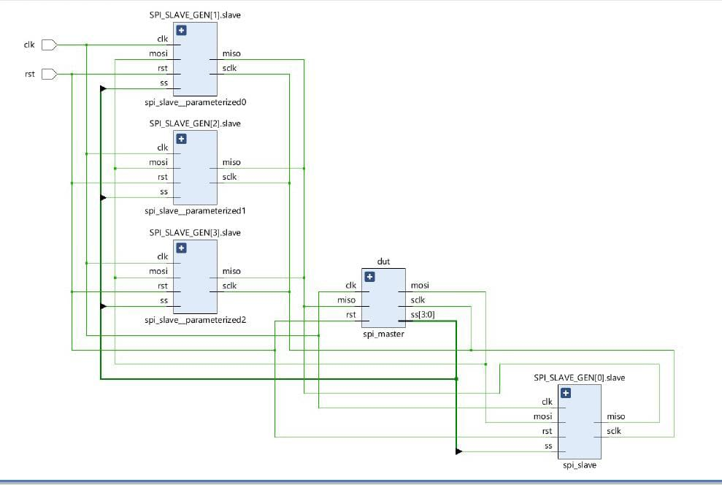
Schematic

Slide 10
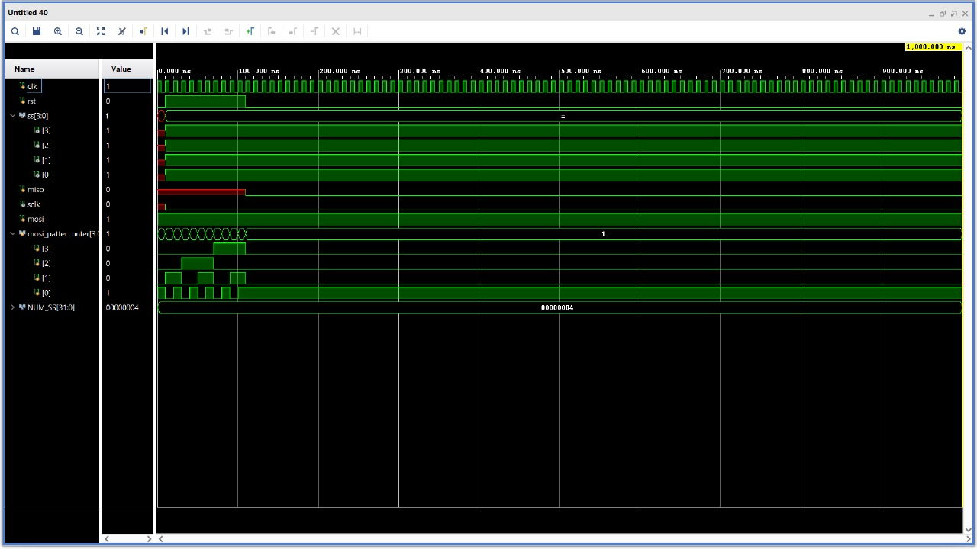
Graphs

Slide 11


